Slide 1

Csd project ACCELERATING ANALYTICS WITH DATABRICKS AND AWS S3

Slide 2
GROUP INSIGHT INNOVATORS
Anisha Kale
Sarvesh Miskin
Ajay Sivaraman
Krishna Sunder
Swati Thakre
Aravind Royal

Slide 3




Problem Statement
Linking
Product Strategy
Establishing Connection between S3 and Databricks
Identifying products with maximum and minimum demand for each month
K-Mart, is an Indian retail corporation that operates a chain of hypermarkets which is present in 10 locations across India. They have incurred heavy losses in the past 2 years due to flawed decision making. To become profitable, the company needs assistance.
Revenue
Margins
Identifying stores with maximum and minimum revenue
Products with maximum demand in each category, modify SP for increased profit margins

Slide 4
Agile Roles
AJAY SIVARAMAN
SWATI THAKRE
ANISHA KALE
SCRUM MASTER
PRODUCT OWNER
DATA ANALYST
SARVESH MISKIN
KRISHNA SUNDER
ARAVIND ROYAL
DATA ANALYST
DATA ENGINEER
DATA ENGINEER

Slide 5
Tech Stack
User Story​ | Tech Stack​ | Acceptance Criteria​
As a data engineer I need to connect AWS S3 to Databricks so that SQL developer can access the data​ ​ | AWS S3 , Databricks​ | Should test the connection established between S3 and Databricks​ Proper access from S3 to Databricks without any impediments​
As a data engineer I need to upload data in S3 buckets so that data can be retrieved from S3 to Databricks​ ​ ​ | AWS S3​ | The data stored in the S3 bucket should be readily accessible.​ The versioning option must be enabled to avoid overwriting existing data​
As a store manager I need to know the in-demand products in each category so that inventory level can be increased.​ ​ | Databricks​ | The query should find in-demand products for every month in a year.​ ​

Slide 6
Tech Stack
User Story​ | Tech Stack​ | Acceptance Criteria​
As a store manager I need to know not in-demand products in each category so that inventory level can be reduced​ | Databricks​ | The query should find not in-demand products for every month in a year.​
As a director of operations, I need to know which store has highest revenue and which has least so that informed business decision can be made.​ | Databricks​ | The result of analysis should clearly show the stores with maximum and minimum review.​
As a data engineer I need to create a report on Products demand so that Store manager can make informed business decisions​. | Power BI​ | The store manager should be able to graphically understand the sales of each product across various months in a year.​ Prediction of sales of each product should be included​

Slide 7
Tech Stack
User Story​ | Tech Stack​ | Acceptance Criteria​
As a data engineer I need to create a report on performance of each stores so that director of operations can make informed business decisions​ ​ ​ | Power BI​ | The director of operations should be able to compare the performance of each stores for both the years to make the right decisions​ ​

Slide 8





Data Analyst role......
Collect
Process
Analyse
Data Insights
Data Integrity
Collected relevant data from client end
Eliminated data redundancy and data inconsistencies
Analyse dataframes in databricks environment
Extract insights from data to make inform business decisions and improve strategies
Ensure data quality and integrity
GitHub

Slide 9
SPRINT 1
From 18/04/23 to 21/04/23
User Story​ | TASKS​ | Acceptance Criteria​
As a Data Engineer I need to normalize the data So that Analyst can query the data effectively​ ​ | Create Facts and Dimension tables and establish relationship between them ​ ​ | No repeated rows of data​ Every tables should contain a primary key​ Dimension table should be related to fact table​

Slide 10
SPRINT 1
From 18/04/23 to 21/04/23
User Story​ | TASKS​ | Acceptance Criteria​
As a data engineer I need to upload data in S3 buckets so that data can be retrieved from S3 to Databricks​ ​ ​ | Uploading dataset as an object into s3​ ​ | The data stored in the S3 bucket should be readily accessible.​ The versioning option must be enabled to avoid overwriting existing data​ ​
As a store manager I need to know the products with maximum sales in each product type so that inventory level can be increased.​ ​ ​ | Create a Databricks cluster to run queries​ Querying the data to find which products are in demand​ | The query should find in-demand products for every month in a year.​

Slide 11
SPRINT 2
From 24/04/23 to 28/04/23
User Story​ | TASKS​ | Acceptance Criteria​
As a store manager I need to know products with minimum sales in each product type so that inventory level can be reduced | Querying the data to find which products has minimum sales​ | The query should find products with minimum sales for every month in a year.​
As a director of operations, I need to know which store has highest revenue and which has least so that informed business decision can be made.​ ​ | Querying to find the store that has maximum revenue​ Querying to find the store with minimum revenue​ | The result of analysis should clearly show the stores with maximum and minimum review.​

Slide 12
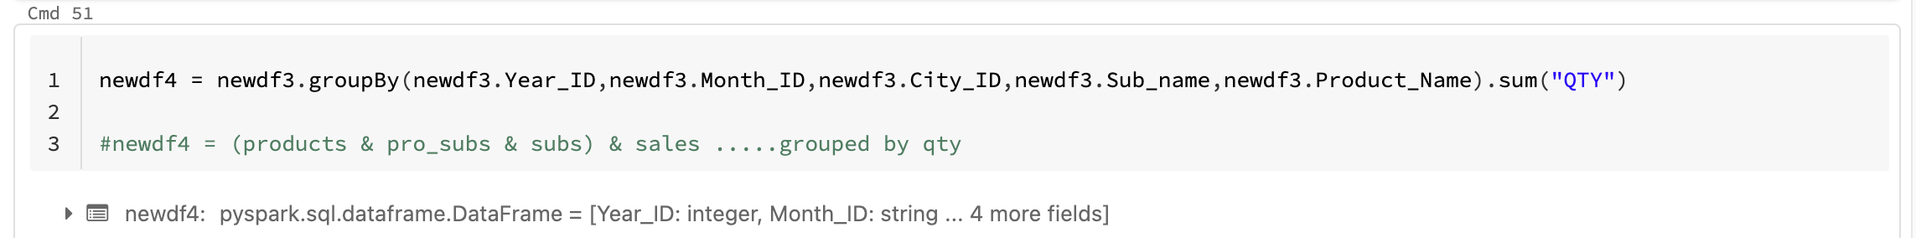
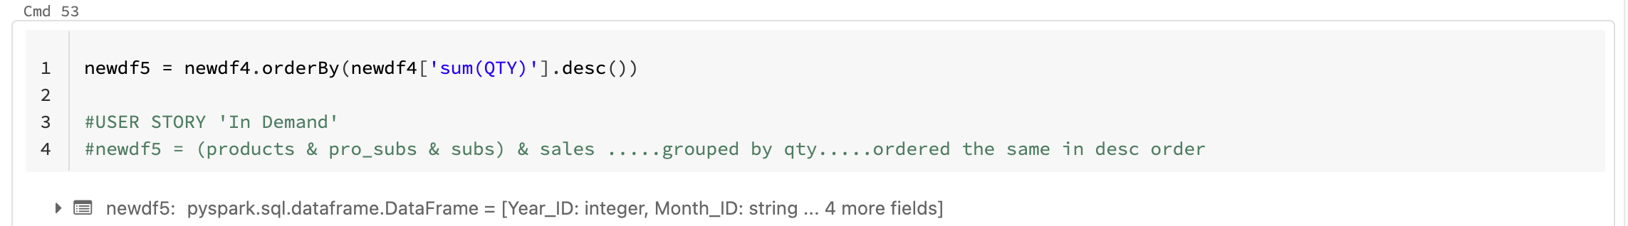
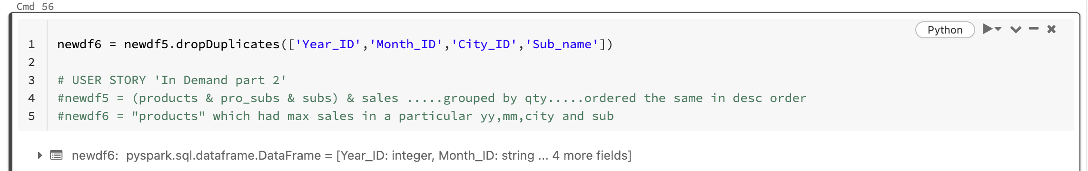
Maximum and Minimum Demand

Slide 13
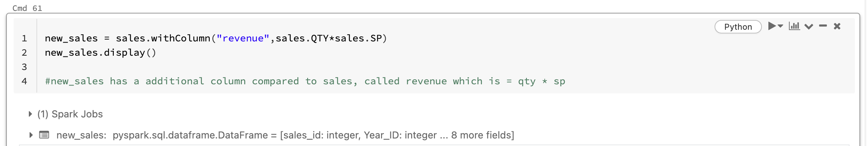
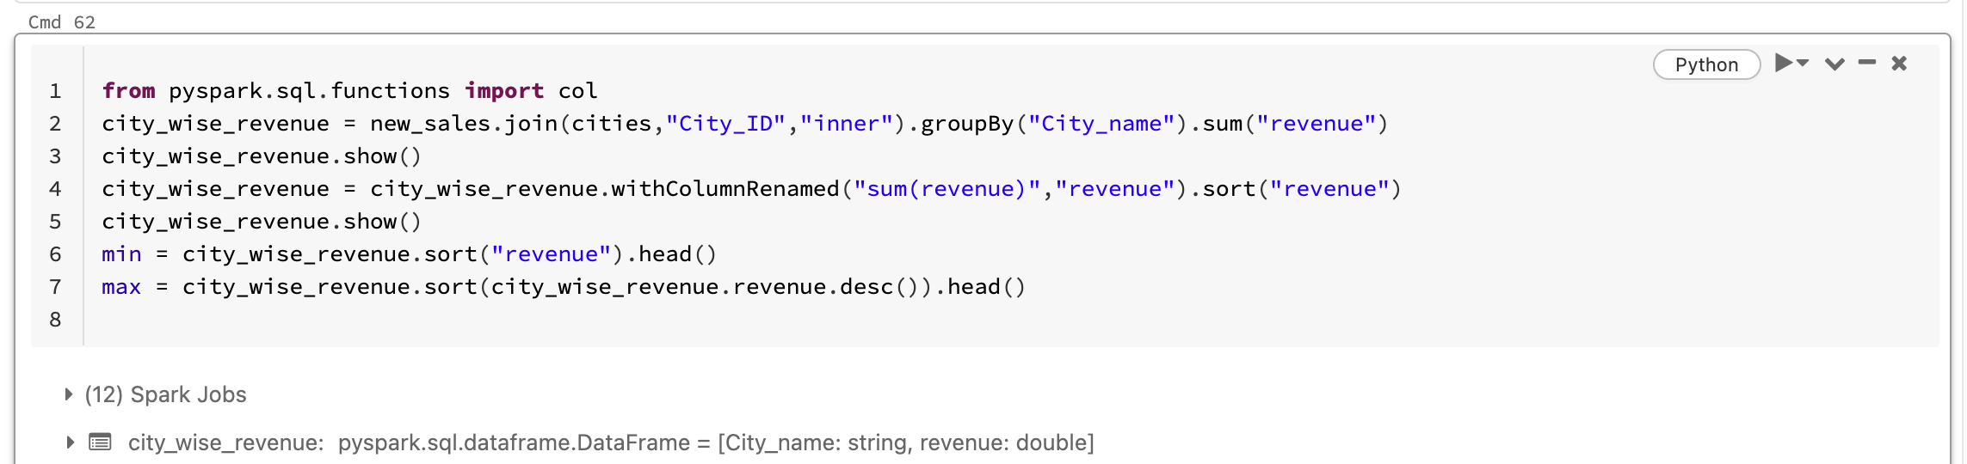
Revenue

Slide 14
SPRINT 2
From 24/04/23 to 28/04/23
User Story​ | TASKS​ | Acceptance Criteria​
As a Store Manager I need a report on sales of each product so that informed business decisions can be made​ ​ ​ ​ | Create a BI dashboards with the query result from Databricks​ ​ | The store manager should be able to graphically understand the sales of each product across various months in a year.​ Prediction of sales of each product should be included​ The dashboard should include supplier name and the amount of profit earned by increasing the selling price.​

Slide 15
SPRINT2
From 24/04/23 to 28/04/23
User Story​ | TASKS​ | Acceptance Criteria​
As a director of operations, I need report on performance of each stores so that informed business decisions can be made​ ​ ​ ​ | Create a BI dashboards with the query result from Databricks​ | The director of operations should be able to compare the performance of each stores for both the years to make the right decisions​ ​

Slide 16
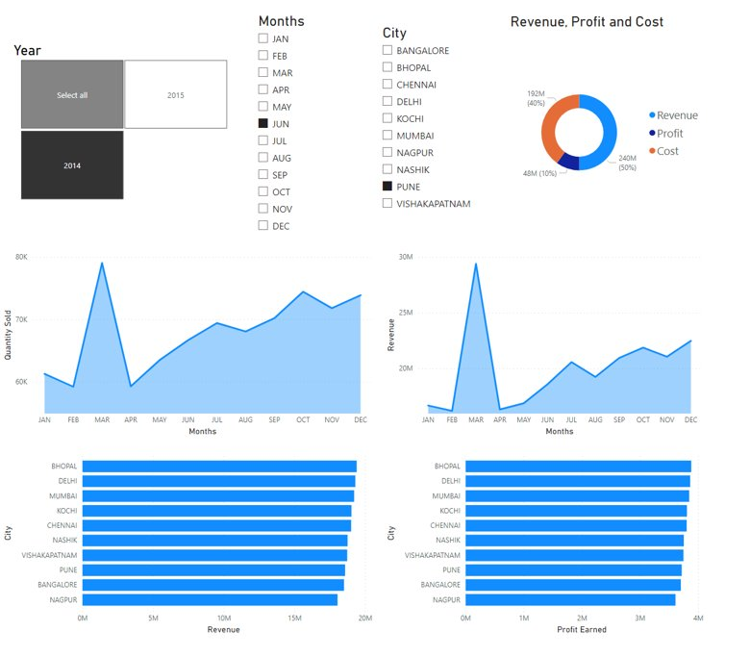
Power BI dashboard
Director Of Operations Dashboard
Store Manager Dashboard

Slide 17
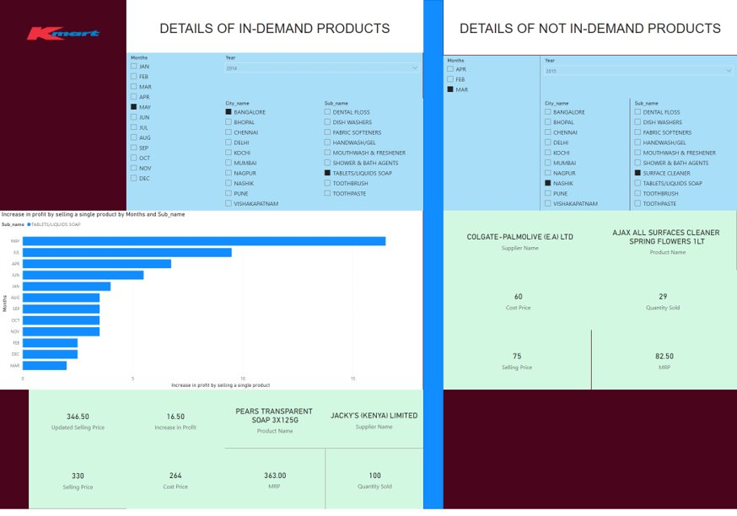

Slide 18
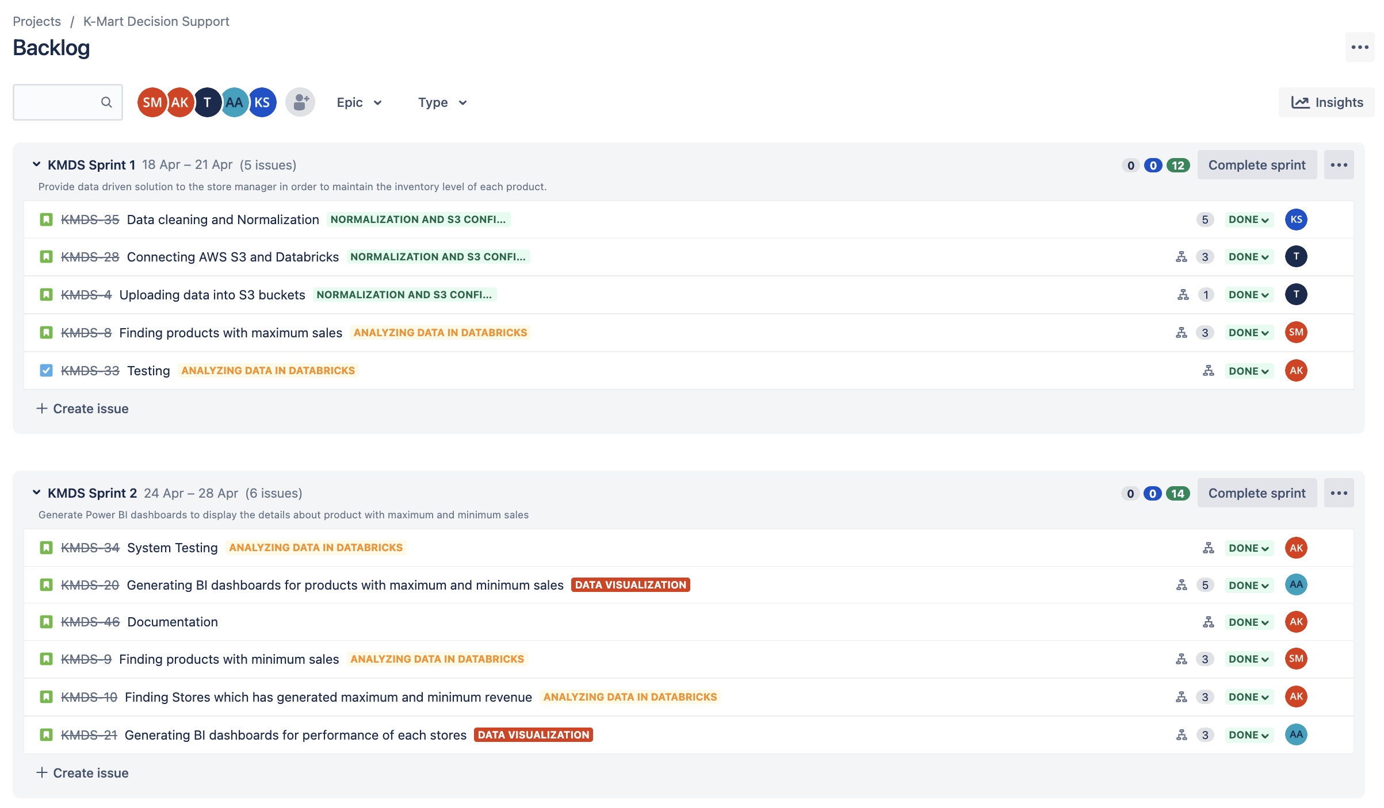
JIRA

Slide 19
Thank You
MD Sarfaraz Ahmad

Slide 20
Appendix

Slide 21

Scrum Ceremonies
Sprint Planning
Ajay is responsible for scheduling the meeting where team decides which user story we will work on in an upcoming sprint
B. Daily Stand-up
A daily 15 min meeting organized by Ajay(Scrum Master) with everyone to take updates of yesterday and today.
C. Sprint Review
Meeting where everyone presents, what they have delivered over a sprint. Generally, the Ajay facilitates the sprint review, and the Swati Thakre gives the demo.
D. Sprint Retrospective
Meeting held by Ajay where team discusses:
1. What went well
2. What didn't go well
3. What should you do differently in next sprint.
Sarvesh Miskin
(Data Analyst)
Ajay Sivaraman
(Scrum Master)
Anisha Kale (Data Analyst)
Swati Thakre (Product Owner)
Aravind Royal (Data Engineer)
Krishna Sunder (Data Engineer )
E. Product Backlog Grooming
Backlog grooming is a regular session where backlog items are discussed, reviewed, and prioritized by swati, and the rest of the team.

Slide 22
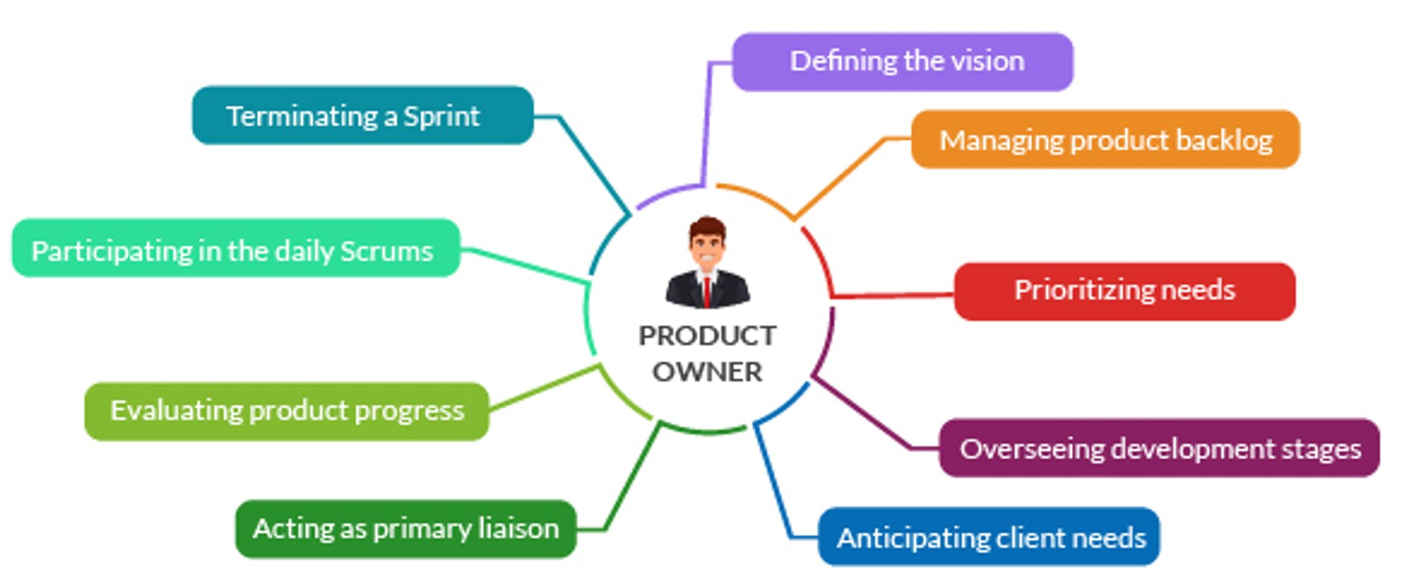
Product Owner Ceremonies

Slide 23

Product Backlog Grooming
Removed outdated user stories and tasks.
Added new user stories that reflect newly discovered user insights.
Broke down broad user stories into smaller items.
Reordered user stories based on their priority
Explained and clearly defined user stories and tasks to avoid uncertainty and “black box” communication.
Assigning or re-assigning story points and estimates.
Identifying roadblocks and minimizing risks related to backlog items.

Slide 24
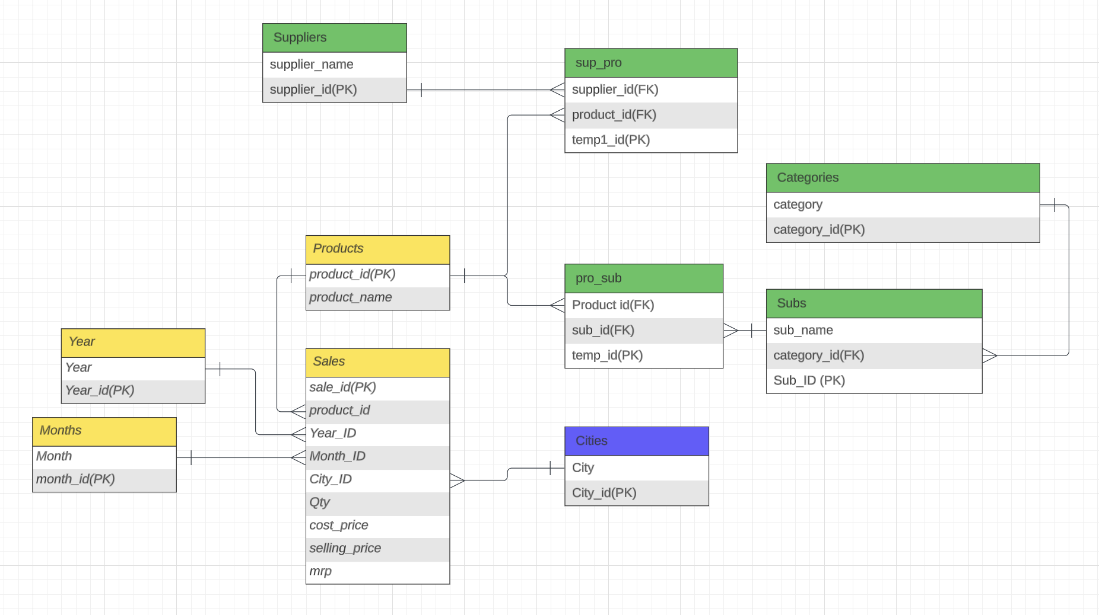
Normalization

Slide 25
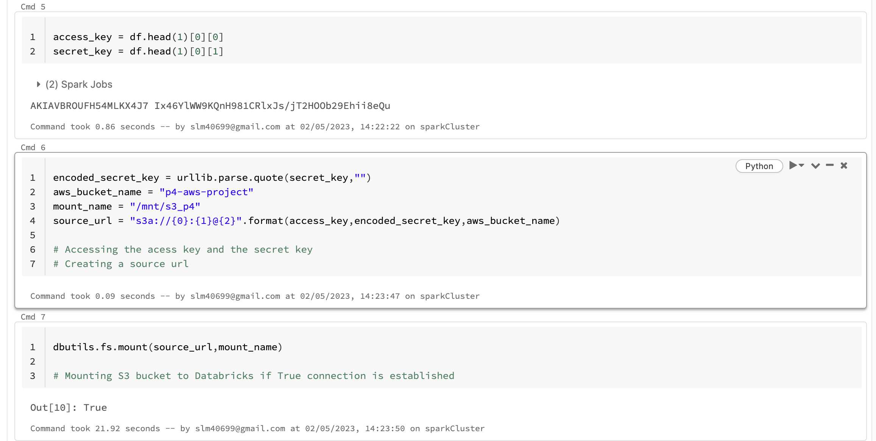
Linking S3 to Databricks

Slide 26
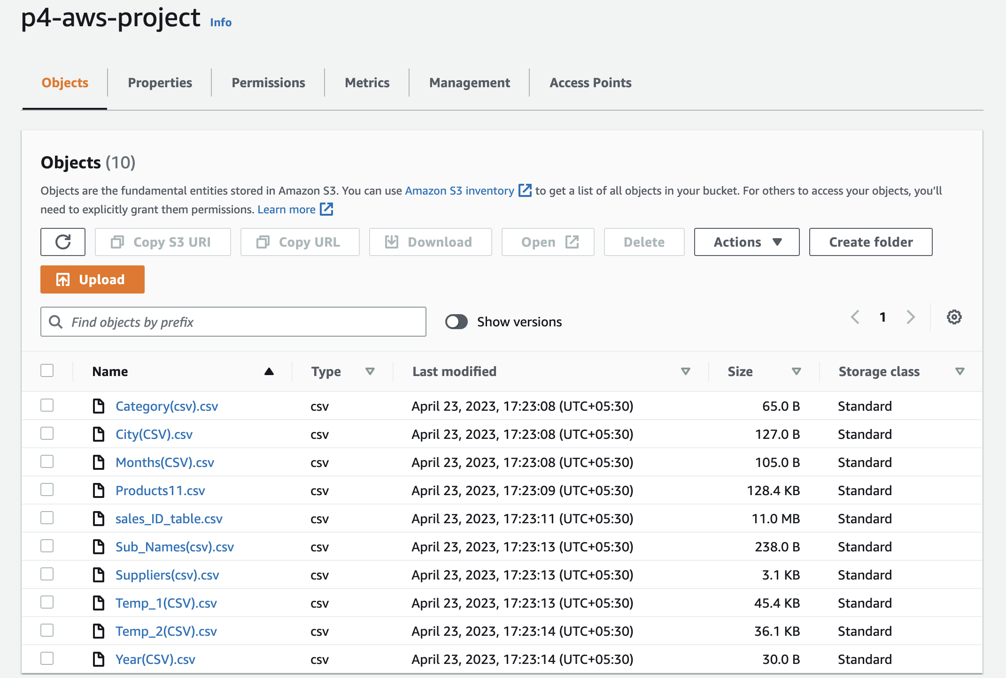
Uploading to S3 Bucket

Slide 27

Best Code Practices
Naming convention:-
Had self-explanatory names for variables and tables.
Our function names followed snake casing.
Class name followed Camel case.
Kept Clear and Concise comments.
Code Indentation was taken care of.
Followed Reusability and Scalability
Followed DRY Principle.

